Slide 1
Restaurant Rating Prediction
Kuldeep Kumar

Slide 2
Objective :
The main goal of this project is to perform extensive Exploratory Data Analysis(EDA) on the Zomato Dataset and build an appropriate Machine Learning Model that will help various Zomato Restaurants to predict their respective Ratings based on certain features.
Benefits :
Gives Better insight of Restaurant
Predict the rating of restaurant by analyzing certain features

Slide 3
Data Sharing Agreement
File name ( Zomato.csv)
Number of columns 17
Number of rows 56251
Column Data Type : String (12), Boolean (2), Integer(1), other (2)

Slide 4
Architecture
Start
Data (batches) For training
Data Validation
Data Transformation
Data Preprocessing
Deployment
Model Saving
Hyperparameter tuning
Get the model for data
Data (batches) For prediction
Export Prediction to csv
End

Slide 5
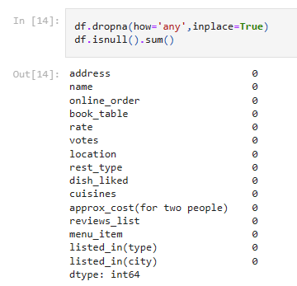
Data Validation and Data Transformation
Removing Null values

Slide 6

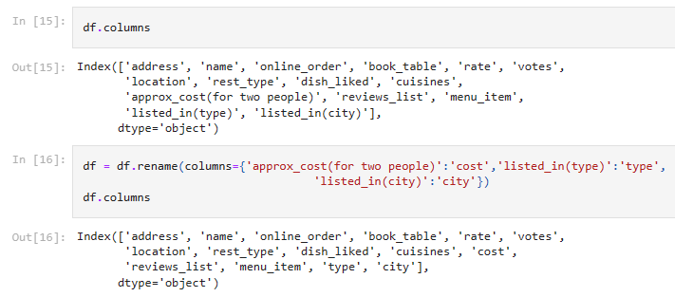
Remove unnecessary columns (features)
Remove duplicates in dataset
Renaming columns according to our convenience

Slide 7
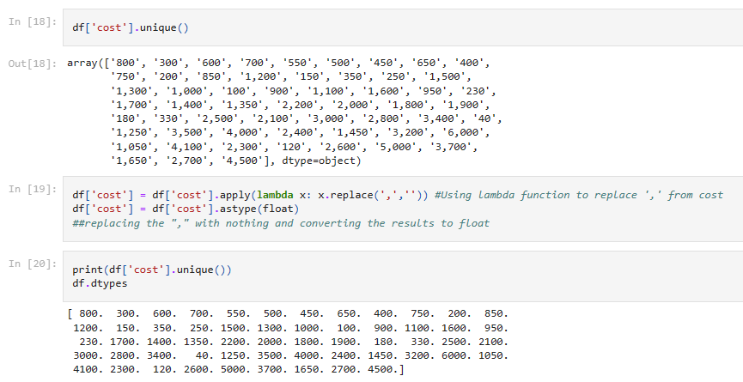
Changing datatype of cost as float

Slide 8
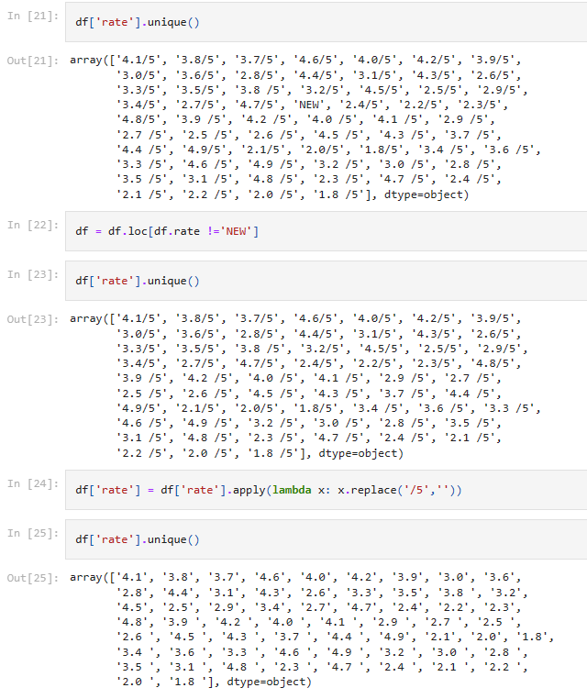
Removing '/5' from Rates and getting rid of 'NEW' as an entry

Slide 9
Model Training
Data preprocessing:
Performing EDA to get insight of data like identifying distribution , outliers, trend among data (most famous restaurants, top liked foods) etc.
Check for null values in the columns. If present impute the null values.
Encode the categorical values with numeric values.

Slide 10
Model Selection:
Built models using Linear Regression, Random Forest, ExtraTree Regressor
ExtraTree Regressor is chosen as its r2 score is high (0.9325151755043354)

Slide 11
Prediction
Model is trained in sets (Train_Test_Split) 30% of data for testing whereas 70% is for training
The sets are preprocessed and data is predicted using ExtraTree Regressor model
The predicted data is saved in Zomata_df_komal.csv

